Slide 1
VIDEO GAME DATABASE
Sam Gamez
Jared Darnell
Steven Lamoreaux

Slide 2
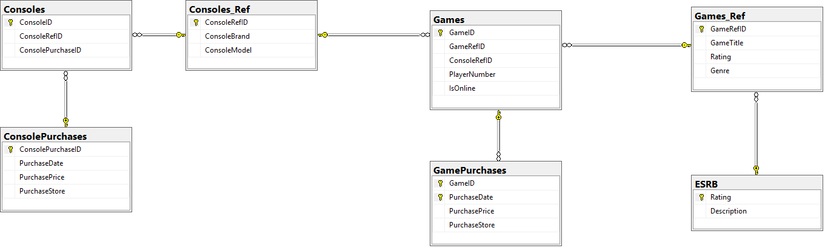
TABLE DESIGN

Slide 3
WHY WE CHOSE OUR TABLE DESIGN
Problems with Referential Integrity
Lookup table for Games and Consoles

Slide 4
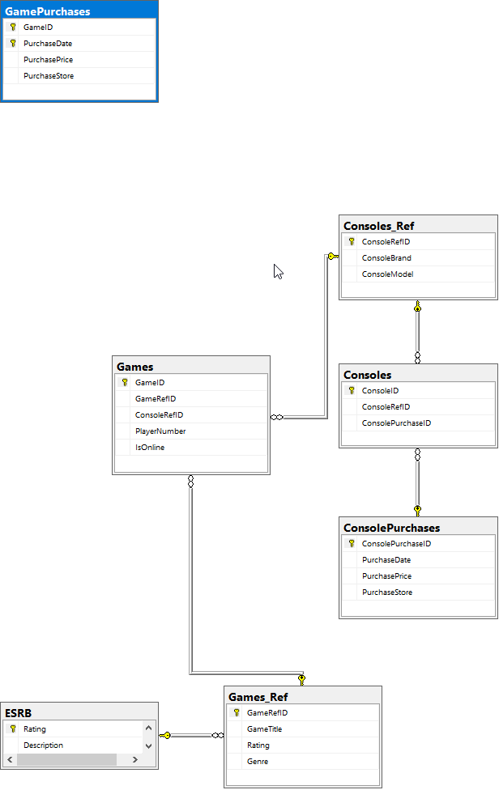
Late-occurring Problem with Design
AFTER:
BEFORE:

Slide 5
OBSTACLES IN GROUP WORK
Source control permissions

